Slide 1
Scikit-learn Introduction
Introduction
Supervised Machine Learning
Clustering
Recommendations
Classifications

Slide 2
Lesson Objectives
Understand some of the basics of Machine Learning (ML)
Learn how Python Scikit-learn supports ML
Become familiar with some of the algorithms in Scikit-learn

Slide 3
Introduction
Introduction
Supervised Machine Learning
Clustering
Recommendations
Classifications

Slide 4
Machine Learning in Python
Python Scikit-learn library provides lots algorithms
Lots of common algorithms are supported
Classification/Regressions
Linear models (linear R, logistic regression, SVM)
Decision trees
K-Means clustering
More
Notes:
There are five types of Linear Models – neural network being one of them.
SVM – Support Vector Machine – algorithm for linearly separable binary data set
Collaborative Filtering -

Slide 5
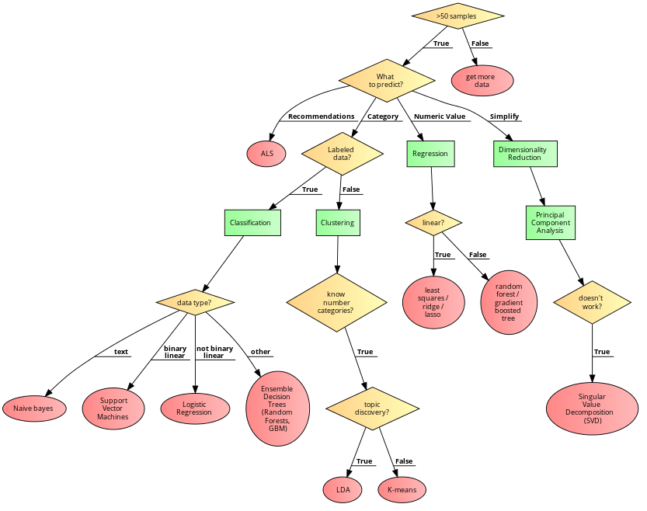
Scikit-learn Algorithm overview

Slide 6
Estimators (base class)
Estimators are classes that have a .fit() method
Mostly, these are classes that are used for prediction:
Regression
Classification
Estimators usually take parameters
>>> estimator.fit(data)
>>> estimator = Estimator(param1=1, param2=2)
>>> estimator.param11

Slide 7
Calling fit()
fit can take one or two arguments
Unsupervised learning:
Typically just the data
Supervised learning: 2 params
Data (as ndarray)
Labels (the correct answer)

Slide 8
Transformer (base class)
Transformers are also Estimators
They have a .fit() function
It may not necessarily be used.
They also can transform data
They also have a .transform() function
A trivial example (taking the log of the input)
Typically transformers are used to process our data
For example, to scale or normalize
>>> transformer = FunctionTransformer(np.log1p)
>>> transformer.transform(np.array[1,2])
[0.69314718, 1.09861229]

Slide 9
Pipelines
Usually we have many estimators and transformers together
We can create a pipeline class to hold a pipeline of estimators and transformers.
Pipeline class
We can combine transformers together
Or provide transformers + final estimator

Slide 10
Prediction
Estimators can also have a predict() method
Used for predicting results of a model
An example classification model using a SVM:
>>> from sklearn import svm
>>> clf = svm.SVC(gamma=0.001, C=100.)
>>> clf.fit(data, label)
>>> clf.predict(np.array([1,2]))
array([3, 4]) # Prediction output

Slide 11
Feature Vectors
Sklearn runs on Feature Vectors stored as ndArrays
Pandas series can be converted to NdArrays is they are numeric (usually float64)
We need to extract columns from Pandas dataframe,
Convert them to ndarrays
But how do we do that?

Slide 12
Categorical Variables
Algorithms run on ndarrays and matrices of type float64
Bool, int64 will be upcasted to float64
Your data may have string or categorical variables
What to do?
For a label:
Use the LabelEncoder
Will convert label into integer value and back.
For a column:
Have to convert into a numeric

Slide 13
Strategy 1: Factorization
Factorization
Call pd.factorize() on the dimension
Will assign an integer to each unique value
E.g. (red = 1, green = 2… etc)
Problems with Factorization
Number may not be meaningful in any way (arbitrary)
Model may try to infer something about ordering.
Model may not understand that these are discrete values
Model may infer some correlation beween values.
“Finding signal in the noise” – can lead to bad results

Slide 14
Strategy 2: Dummy Variables
We can use Dummy Variables
Aka One Hot Encoding
This will generate One hot encoded features.
from sklearn.preprocessing import OneHotEncoder
fact = pd.factorize(dimensions)
OneHotEncoder().fit(fact).transform(fact)

Slide 15
Strategy 3: Quantization
Turn the category into a real-world number
Example colors:
Red = 450MHz
Green …
Usually join (pd.merge) to a ”lookup table”

Slide 16
Scaling and Normalization
Usually data needs to be cleaned up and transformed before creating features
Scaling
StandardScaler class will scale data down
Remove high magnitude data
Normalization
Will use Z-scoring to norm

Slide 17
Data Whitening (PCA)
Introduction
Supervised Machine Learning
Data Whitening (PCA)
Clustering
Recommendations
Classifications

Slide 18
Data Whitening
Data that is heavily correlated may need to be whitened.
This means de-correlated.
One way to do this is with PCA: Principal Component Analysis.
PCA can also be used to reduce dimensionality

Slide 19
Principal Component Analysis (PCA)
Not all dimensions are equally interesting. Can we reduce the 'dimensionality' of data, without loosing too much information?
PCA does just that
It finds low-dimensional representation of data that contains as much as possible of variation
PCA seeks a small number of dimensions that are as interesting as possible
Interesting is measured by the amount that the observations vary along each dimension

Slide 20
Using PCA for Visualization
If we reduce dimensions to 2 or 3, we can visualize highly dimensional data
Great alternative to Scatter Plot Matrices

Slide 21
PCA Theory: Eigen Vectors / Values
∑ Math ∫
Say we are measuring the following responses
Age, hours on the internet
2 variables → 2 dimensional dataset → 2 Eigen Vectors
If we measure
Age, hours on the internet, hours on the mobile phone
3 variables, 3 dimensional dataset → 3 Eigen vectors
So number of Eigen vectors = number of dimensions
EigenVector is a direction – vertical, horizontal, 45' degrees ..etc
EigenValue is a number – denoting how much 'variance' in the data in that vector's direction
Eigen Vector and Eigen Value go together (E Vector, E Value)
EigenVector with highest EigenValue (meaning lot of variance in that direction) becomes a Principal Component

Slide 22
PCA Math: Eigen Vectors
∑ Math ∫
In the plot below, EigenVector (ev1) is shown that crosses the data with 'highest variance'
Notes:
Image adopted with thanks to: https://georgemdallas.wordpress.com/2013/10/30/principal-component-analysis-4-dummies-eigenvectors-eigenvalues-and-dimension-reduction/

Slide 23
PCA Math: Eigen Vectors
∑ Math ∫
But we have a 2-dimensional data → 2 eigen vectors
To maximize coverage the second EigenVector will be orthogonal (90 degrees) to the first one (ev1)
Notes:
Image adopted with thanks to: https://georgemdallas.wordpress.com/2013/10/30/principal-component-analysis-4-dummies-eigenvectors-eigenvalues-and-dimension-reduction/

Slide 24
PCA Math: Eigen Vectors
∑ Math ∫
The EigenVectors have given us more useful axis to frame data
Remember, the data hasn't changed at all, we are just looking at it from a different perspective
Notes:
Image adopted with thanks to: https://georgemdallas.wordpress.com/2013/10/30/principal-component-analysis-4-dummies-eigenvectors-eigenvalues-and-dimension-reduction/

Slide 25
PCA on Oxford Internet Study
Say there were
2500 people interviewed == 2500 observations
15 questions = 15 dimensions = 15 EigenVectors & Values
Say our 15 Eigen Values are (in descending order) [ 25, 22, 20, 17, 10, 7, 6, 5, 4, 3, 1, 0.5, 0.4, 0.3, 0.1 ]
We see the first 4 have the biggest values
Indicating 4 directions with lots of information
We have identified our 4 Principal Components (PC)
We have gone from 15 attributes to 4 (call them PC1, PC2, PC3, PC4)

Slide 26
Principal Components
First Principal Component (PC1) has the largest variance (EigenValue)
Second Principal Component has second largest variance that is uncorrelated to PC1
Orthogonal vector to PC1

Slide 27
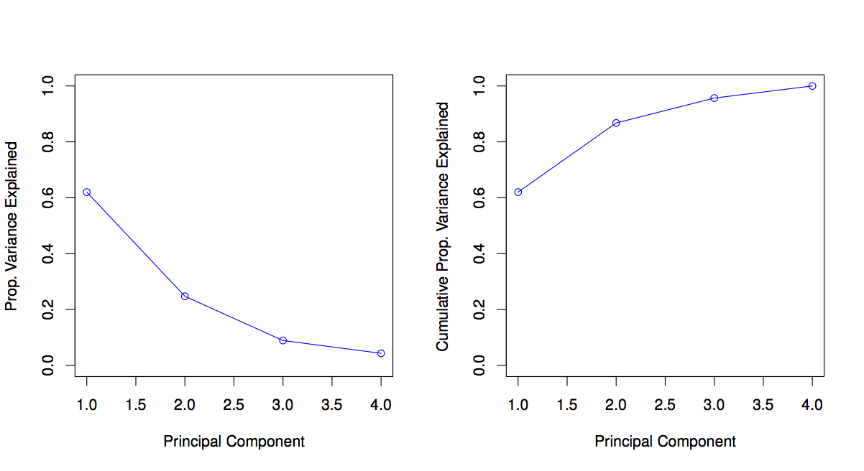
Evaluating PCA – Scree Plot
We use a scree plot to understand PCA
Left chart plots Variance for each PC component.
First component (PC1) has the most (62%)
Second one PC2 around 25%
PC4 hast the least
Right graph shows 'accumulated' variance when combining PCs. We are moving towards ONE

Slide 28
Clustering
Introduction
Supervised Machine Learning
Clustering
Recommendations
Classifications

Slide 29
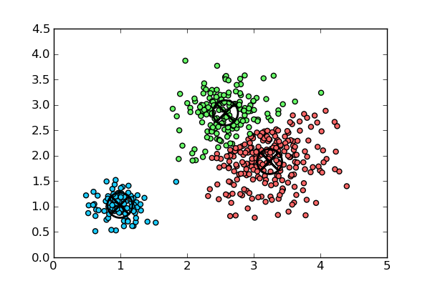
Clustering Vectors
There are many different clustering algorithms for vectors.
Simplest is k-means
K-means requires a known value of k (number of clusters) to start with.

Slide 30
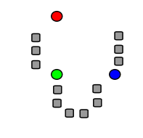
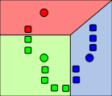
K-Means Clustering
K-Means: Simplest Clustering Algorithm.
Step 1: k numbers of points (centroids) are pre-seeded in the data. Example: 3 centroids (red, green, blue)
Step 2: Each point in the dataset is associated with its nearest centroid, as determined by a distance measurement.

Slide 31
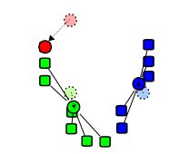
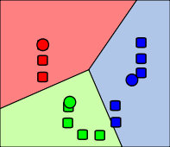
K-Means Clustering
Step 3: The centroid (geometric center) of the clustered points becomes the new centroid of that cluster. Each centroid is updated.
Step 4: Repeat steps 2 and 3 until convergence is reached (the points move less than the threshold amount).
Notes:
Ways to Determine Distance between points
Euclidian distance – (most obvious) Euclidian, which takes the distance in Euclidian space
Cosine Distance – cosine of angle between vectors – ignores magnitude
Manhattan distance: Effectively counts the number of square blocks one would “walk” to get there without cutting corners.
Tanimoto distance Take both angle and magnitude into account.
Most algorithms attempt to balance the
Magnitude
Angle

Slide 32
K-Means Clustering Summary
K-Means is simple
Well-understood.
Easy to parallelize
Disadvantages:
Value of k must be known in advance, which may mean running the exercise many times to get optimum results.
Initial centroid positions are important; may cause long convergence.
Dense groupings of points are not especially considered
Outliers may bias results.
Clusters not broadly (hyper)spherical don’t work well for k-means.
Use hierarchical clustering for these situations.
Notes:
Hierarchical Clustering is a cluster analysis that seeks to build a hierarchy of clusters.

Slide 33
K-Means in Scikit-learn
Scikit-learn has good support for k-means
How to perform k-means clustering in Scikit-learn
Put data in ndarray
Perform clustering with a specified number of iterations
Evaluate the “fit” of the cluster. Is it a good run?
If not, change the number of clusters (value of k)
Once we have a good clustering run:
Map each vector to its nearest cluster
Group original data by its corresponding cluster
Assign (predict) new vectors to their nearest cluster

Slide 34
K-Means in Scikit-learn
k-means clustering
Default values: just provide KMeans(df, value-of-k)
How many iterations should you have?
“It depends”… too low and you might get bad results
Too many and you waste time
Try 10-20
from sklearn.cluster import kmeans
kmeans = KMeans(n_clusters=2, random_state=0).fit(X)

Slide 35
Evaluating Cluster Performance
WSSSE: Within Set Sum of Squared Errors
WSSSSE = kmeans._inertia
COST = sum of squared distances of points to cluster center.
What does this mean?
WSSSE will decrease with increasing values of k.
“Law of Diminishing Returns”
High values of k give marginal gain.
We can iterate across k until we get good results.

Slide 36
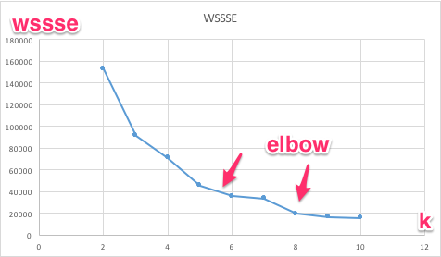
The Elbow Method
Identify the “elbow” on the curve
Example: What value of K to select in this case?
Notes:
Elbow method is basically plotting “variance” % of a data against number of clusters and find the point after which adding more clusters will not make a huge difference. That is called Elbow method.

Slide 37
Using KMeansModel
How to apply the model to data?
Use predict:
kmeans.predict(Vector)
int clusterId = model.predict(Vector.dense())
Predict returns an integer
Cluster number, i.e., 0, 1, 2, 3… (k-1).
Notes:
KMeansModel is a clustering model for K-means. Each point belongs to the cluster with the closest center.
Method Predict maps given points to their cluster indices. Returns the cluster index that a given point belongs to.

Slide 38
Handling New Data
New Data be assigned on the existing model:
Make a Vector out of the new Data
Call KMeansModel.predict(vector), to get cluster membership as a number (integer)
The new data will not affect the existing cluster locations.

Slide 39
Lab : KMeans Clustering on Flights
Lab
Overview: Try clustering flights dataset
Use NYCFlights
Builds on previous labs: None
Approximate time: 20-30 min.
Follow: sklearn/kmeans/README.md
kmeans=KMeans(n_clusters=2,random_state=0).fit(X)

Slide 40
Classification /Regression
Introduction
Supervised Machine Learning
Clustering
Recommendations
Classification / Regression

Slide 41
Classification and Regression
Classification and Regression are both supervised ML.
Both are to make a prediction
Classification: predict a categorical variable
Could be binary (yes/no)
Regression: predict a real number
We ”fit” the model with training data and labels
We can evaluate the model
Then we “predict” new data.

Slide 42
Review of Classification Algorithms
Naïve Bayes
Support Vector Machines (using Stochastic Gradient Descent)
Logistic Regression/MaxEntropy
Decision Trees
A basic decision tree is pretty simple.
It is a set of rules collect the rule
Decision-tree learning is a means of inferring an appropriate decision tree from the data.
Notes:
SGD – Stochastic Gradient Descent – is a learning algorithm for large data – helps with optimization of risk.
SGD is used when companies don’t have time to “train” to handle or solve a problem.

Slide 43
Support Vector Machines (SVMs)
Support Vector Machine is a classification method that is:
Supervised (trained)
Linear
Binary (splits into two classes) (E.g., Spam or not-spam)
Crisp (not fuzzy, not probabilistic)
How does it work?
Draw a line (hyperplane) that separates the two classes
Line should perform best possible separation
Maximize distance between line and closest points.

Slide 44
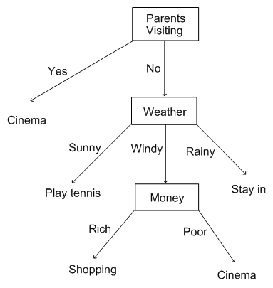
Decision Tree

Slide 45
Classification Support in Scikit-learn
The following algorithms are well-represented in Scikit-learn:
Linear methods: SVM, Logistic Regression
Decision trees
Ensemble decision trees (Random Forests, Gradient Boosted Trees)
Naïve Bayes

Slide 46
Evaluating Classification Models
Let's consider a binary classifier
Picks one of two outcomes (spam / not-spam)
Two approaches
Confusion matrix
ROC curve

Slide 47
Confusion Matrix / Error Matrix
Let's consider a binary classifier
Picks one of two outcomes (spam / not-spam)
Say we are classifying 10 emails (6 spam, 4 not-spam)
See 'confusion matrix' below
Classification => | Spam | Not Spam
Actual Spam (6 total) | 4 count 66% accuracy Correct True-Positive Rate (sensitivity) | 2 count 33% Incorrect False negative rate (miss rate)
Actual Not Spam (4 total) | 1 count 25 % Incorrect False-positive rate (fall-out) | 3 count 75% Correct True negative rate (specificity)

Slide 48
Confusion Matrix: More Than 2 Outcomes
 |  | Predicted
Actual |  | Cat | Dog | Rabbit
 | Cat (8) | 5 | 3 | 0
 | Dog (6) | 2 | 3 | 1
 | Rabbit (13) | 0 | 2 | 11
Algorithm has trouble classifying cats / dogs (too many mis-classification)
Can classify rabbits pretty well (less mis-classifications)

Slide 49
Confusion Matrix
 |  | Predicted Condition
 |  | Predicted Positive | Predicted Negative
Actual condition | Positive | True positive | False negative Miss rate - Guilty prisoner was not convicted
 | Negative | False Positive Sensitivity False alarm 'Crying wolf' Hiring someone who is not qualified | True negative
Notes:
Story : A shepherd who cried wolf

Slide 50
Confusion Matrix : Calculations
Accuracy Overall how accurate is the model? = (TP + TN) / total = (90 + 70) / 200 = 0.8 or 80%
Mis-classification / Error rate How wrong is the model? = (FP + FN) / total = (10 + 30) / 200 = 0.2 or 20% = 1 - accuracy
 |  | Predicted Condition
 |  | Predicted Positive | Predicted Negative
Actual condition (n = 200) | Positive (n = 120) | True positive (n = 90) | False negative (n = 30)
 | Negative (n = 80) | False Positive (n = 10) | True negative (n = 70)
Notes:
http://www.dataschool.io/simple-guide-to-confusion-matrix-terminology/

Slide 51
Confusion Matrix : Calculations
True Positive Rate (TPR) How often model predicts 'positive' as 'positive' (correctly) ? = TP / actual positive = 90 / 120 = 0.75 or 75%
False Positive Rate (FPR) How often model predicts 'negative' as 'positive' (incorrectly) = FP / actual negative = 10 / 80 = 0.125 or 12.5%
 |  | Predicted Condition
 |  | Predicted Positive | Predicted Negative
Actual condition (n = 200) | Positive (n = 120) | True positive (n = 90) TPR = 75% | False negative (n = 30)
 | Negative (n = 80) | False Positive (n = 10) FPR = 12.5% | True negative (n = 70)
Notes:
http://www.dataschool.io/simple-guide-to-confusion-matrix-terminology/

Slide 52
Confusion Matrix : Calculations
Specificity How often model predicts negative' as negative' (correctly) ? = TN / actual no = 70 / 80 = 0.875 or 87.5 % = 1 - FPR
Precision When model predicts 'positive' how often it is right? = TP / predicted positive = 90 / (90 + 10) = 0.9 or 90%
 |  | Predicted Condition
 |  | Predicted Positive | Predicted Negative
Actual condition (n = 200) | Positive (n = 120) | True positive (n = 90) TPR = 75% | False negative (n = 30)
 | Negative (n = 80) | False Positive (n = 10) FPR = 12.5% | True negative (n = 70) Specificity = 87.5%
Prevalence How often does 'positive' occurs in our sample = actual positive / total = 120 / 200 = 0.6 or 60%
Notes:
http://www.dataschool.io/simple-guide-to-confusion-matrix-terminology/

Slide 53
Confusion Matrix : Calculations
Positive Predictive Value (PPV) Similar to precision, takes 'prevalence' into account = TP / (TP + FP) = 90 / (90 + 10) = 0.90 or 90%
Null Error Rate
How often the model would be wrong if it always predicted the majority class?
Here our majority = Positive
If we always predicted 'positive' we would be wrong 80 times (negative)
80/200 = 40% of time
 |  | Predicted Condition
 |  | Predicted Positive | Predicted Negative
Actual condition (n = 200) | Positive (n = 120) | True positive (n = 90) TPR = 75% | False negative (n = 30)
 | Negative (n = 80) | False Positive (n = 10) FPR = 12.5% | True negative (n = 70) Specificity = 87.5%
Notes:
http://www.dataschool.io/simple-guide-to-confusion-matrix-terminology/
https://en.wikipedia.org/wiki/Positive_and_negative_predictive_values

Slide 54
How is ROC Curve Generated
Y-axis : True Positive Rate (TPR)
Actual=positive, predicted=positive
Correct!
X-axis : False Positive Rate (FPR)
Actual=negative, predicted=positive
Incorrect!
0.0 <= TPR & FPR <= 1.0
Plot TPR / FPR while varying 'threshold'

Slide 55
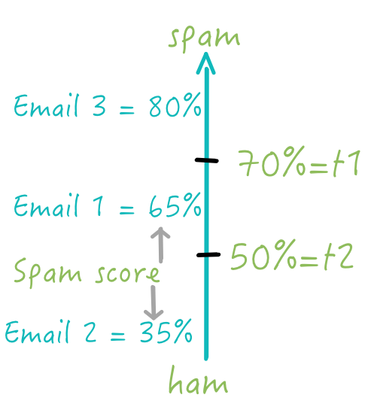
Threshold
Our spam classifier provides a 'spam probability' for each email
Probability is between 0.0. and 1.0 (or 0 to 100%)
1.0 definitely spam
0.0 definitely not spam
When an email's 'spam score' is above a certain number we mark it as spam
This is called 'threshold'
If spam threshold is lower (say 50%)
more emails will be classified as spam (email2, email3)
Users will miss emails (as they are in Spam folder)
If spam threshold is higher (70%)
Fewer emails will be classified as spam (email2)
Users will see more spam emails be in Inbox
We need to find the sweet spot !

Slide 56
Threshold
In first table our threshold is 0.7
90 emails are correctly predicted as spam
Next table, our threshold is higher 0.8
Only 70 emails are classified as spam
Lower TPR
 |  | Predicted Condition
Threshold = 0.7 |  | Predicted Spam | Predicted Not Spam
Actual condition (total = 200) | Spam (n = 120) | True positive (n = 90) TPR = TP / positive = 90/120 = 75% | False negative (n = 30)
 | Not Spam (n = 80) | False Positive (n = 10) FPR = FP / negative = 10/80 = 12.5% | True negative (n = 70)
 |  | Predicted Condition
Threshold = 0.8 (higher) |  | Predicted Spam | Predicted Not Spam
Actual condition (total = 200) | Spam (n = 120) | True positive (n = 70) TPR = TP / positive = 70 / 120 = 58.33% | False negative (n = 50)
 | Not Spam (n = 80) | False Positive (n = 8) FPR = FP / negative = 8 / 80 = 10% | True negative (n = 72)

Slide 57
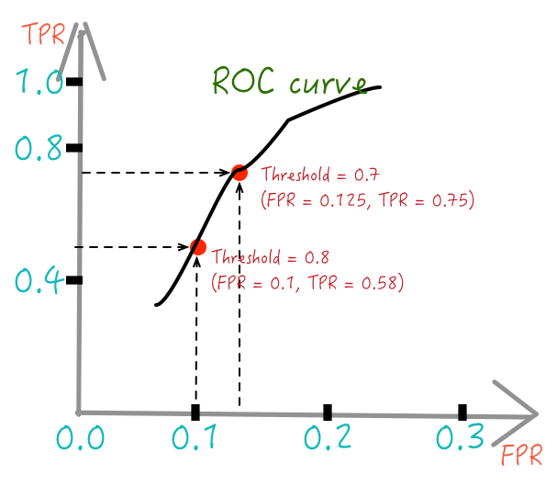
ROC Curve : Receiver Operating Characteristic

Slide 58
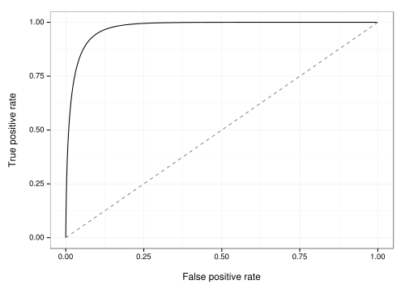
ROC Curve Example

Slide 59
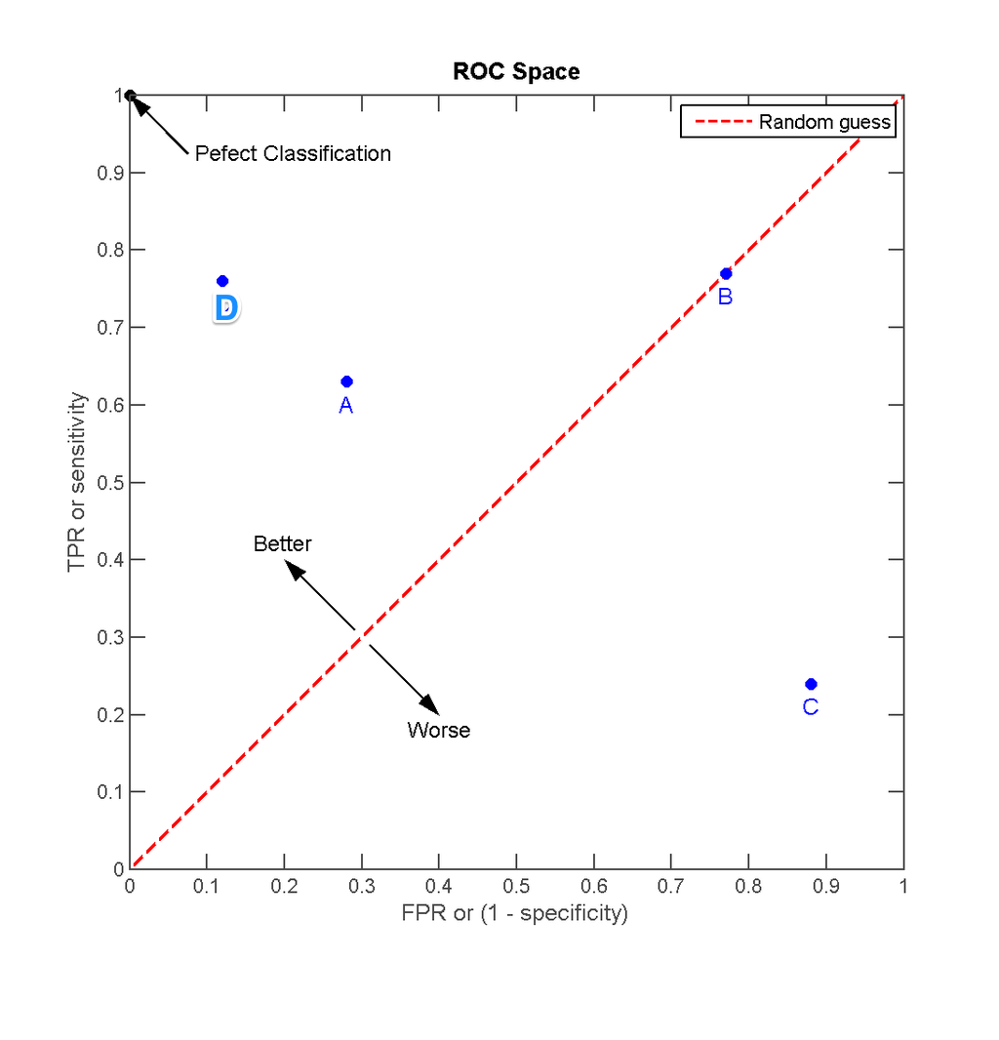
Interpreting ROC Curve
The red-line plots 'random guess' = B
Approaching 'top left' corner would be a perfect classifier! So D is better A
C performs worse than random → bad
Notes:
https://en.wikipedia.org/wiki/Receiver_operating_characteristic
http://www.dataschool.io/roc-curves-and-auc-explained/
Image credit (CC) : https://commons.wikimedia.org/wiki/File:ROC_space-2.png

Slide 60
Interpreting ROC Curve
Shows tradeoff of TPR (sensitivity) vs. FPR (1 – specificity)
The closer to top-left , the more accurate the model
Upper left corner (0,1) = perfect classification!
The closer to middle line (45 degree) the less accurate the test
Middle line represents : random classification (50%)

Slide 61
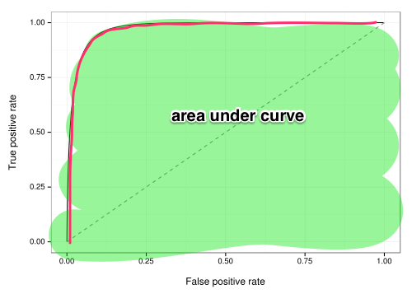
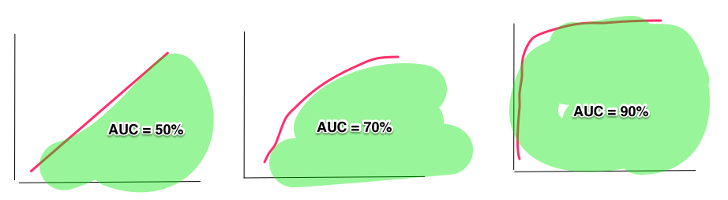
Area Under Curve – AUC (ROC Space)
Measures the percentage of area 'under the curve'
AUC is between 0 and 1
Higher AUC → more accurate the model
See 3 scenarios below
Left most is bad (50%)
Middle : OK (70%)
Right most : very good (90%)

Slide 62
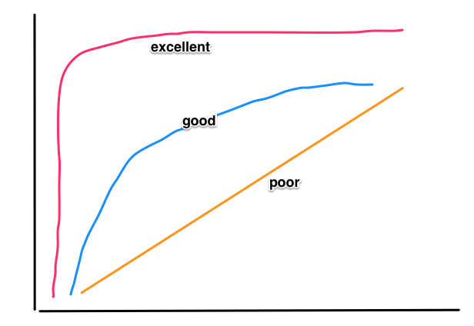
Using AUC to Measure Accuracy
Accuracy can be specified using a grading system
AUC | Grade
0.9 – 1.00 | A - Excellent
0.80 – 0.90 | B - good
0.70 - 0.80 | C - fair
0.60 – 0.70 | D - poor
0.50 – 0.60 | F - Fail
Notes:
https://www.youtube.com/watch?v=21Igj5Pr6u4
http://gim.unmc.edu/dxtests/roc3.htm
Image credit (CC) : http://gim.unmc.edu/dxtests/roc3.htm

Slide 63
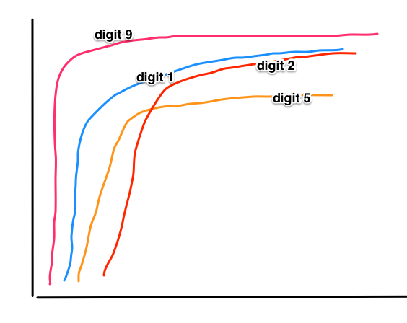
ROC / AUC For Multiclass Classifiers
Say our algorithm recognizes hand-written digits (postal code) into numbers.
Its ROC can be drawn as follows

Slide 64
Lab: Classification
Lab
Overview: In this lab, we will use the “nycflights13” dataset for predicting delayed flights
We will use logistic regression as a
Builds on previous labs: None
Approximate time: 25-35 min.

Slide 65
Recommendations
Introduction
Supervised Machine Learning
Clustering
Classification/Regression
Recommendations

Slide 66
Collaborative Filtering
Collaborative Filtering (CF) is commonly used in “Recommended For You” or “More Like This” functionality
Recommendations can be explicit (based on user ratings), or implicit (based on user interest)
CF is expressed as Users -> Items
However, any correlation could be modeled as users to items
Users and Items could be the same (example: dating site)

Slide 67
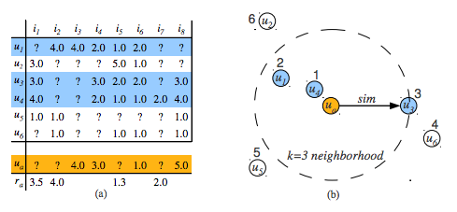
Ratings Matrix: Users/Movies
Notes:
This is a matrix of users and items. Users in rows and items in columns.
When a user rates a item, that particular cell gets filled. Lot of empty cells – sparse matrix.
Source: https://cran.r-project.org/web/packages/recommenderlab/vignettes/recommenderlab.pdf

Slide 68
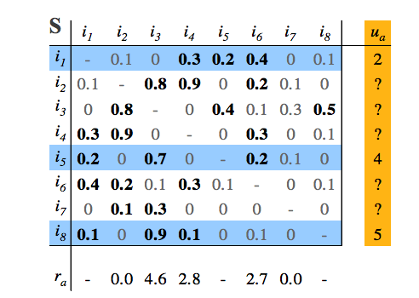
Item Ratings Matrix - Normalized
Notes:
Normalizing addresses discrepancy on scales of each of the raters.

Slide 69
Recommendations in Python
There is a specialized library called scikit-surprise for Recommendations
Has several ways of performing recommendations
SVD (Singular Value Decomposition)
ALS (approximation of SVD)
K-Nearest Neighbors

Slide 70
Preparing Data for Scikit-surprise
Scikit-surprise only looks at integer userid and itemid.
Assign your data with unique integer userid and itemid.
Preferences are expressed as a double (higher is better)
What if your preferences are binary (yes/no)?
Assign a number, say, 5.0 for yes, and 1.0 for no.
What if preferences are just “implied”?
User viewed item as 5.0, no data for unviewed item.
Scikit-learn Rating: Integer, Integer, Double

Slide 71
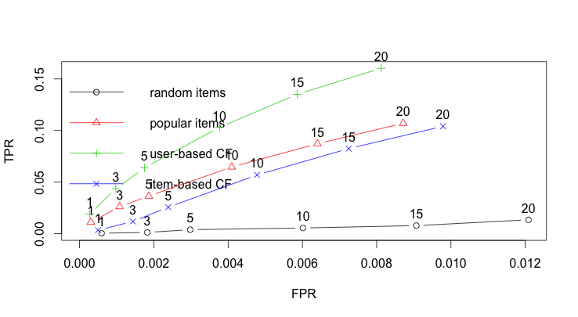
Evaluating CF Recommendations (ROC)
True Positive Rate
False Positive Rate
Notes:
https://en.wikipedia.org/wiki/Receiver_operating_characteristic

Slide 72
Lab : Recommendations
Lab
Overview: We will use Movielens example
There are a number of TODOs to finish in the code
Builds on previous labs: None
Approximate time: 20-30 min.
Follow: 6-Scikit-learn/recs/README.md
Notes:
To read the file use either
less README.txt
nano README.txt
Image credit: simpsonswiki.com

